Slide 1

Algorithms
Lesson 2: Pattern recognition

Slide 2
Objectives
In this lesson, you will learn:
how to solve a range of problems by combining decomposition, abstraction and algorithm design with pattern recognition
the benefits of a modular approach to programming.

Slide 3
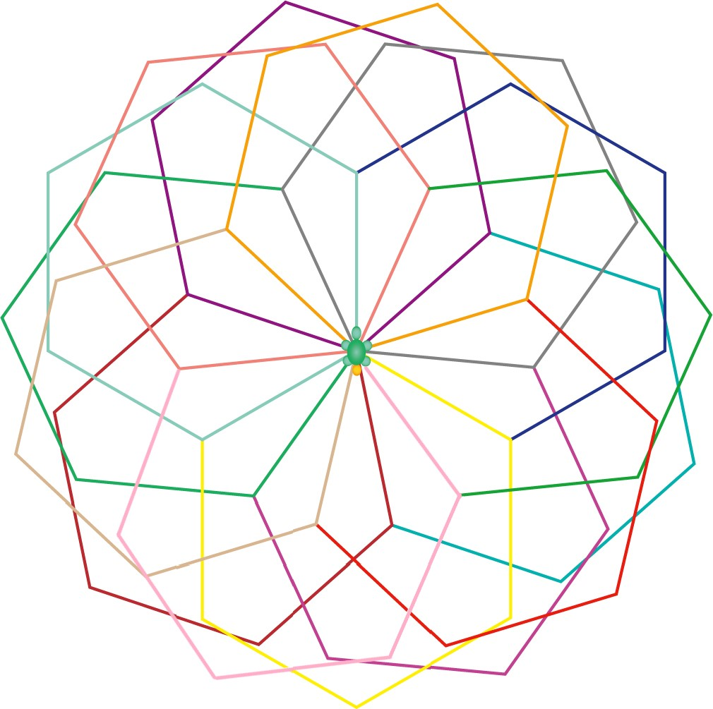
One flower

Slide 4
Pattern recognition
Pattern recognition is the fourth cornerstone of computational thinking.
It is an important part of problem solving because, if you can identify similarities between two different problems, you might be able to apply the same or a slightly modified solution to both problems.
This enables computer programmers to work efficiently, solving problems more quickly and writing less code.

Slide 5

Activity 2.1: Flower design problem

Slide 6
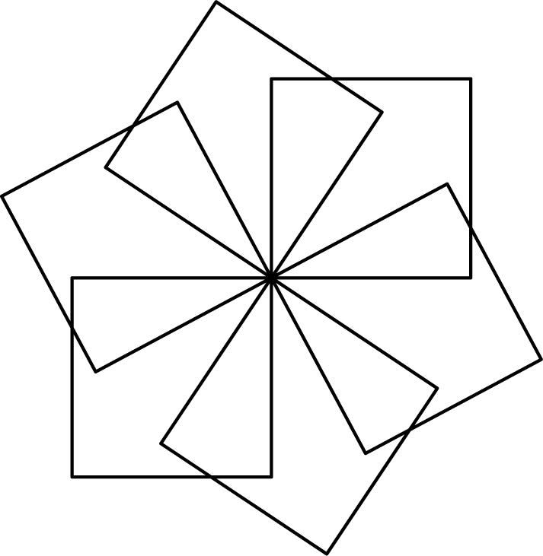
Two flowers

Slide 7
Computational thinking
When you were thinking about the flower designs, you were carrying out computational thinking.
When you were identifying patterns in the original flower, you were decomposing the flower and carrying out pattern recognition.
When you made a list of elements that could be removed or changed and still leave a recognisable flower design, you were carrying out abstraction.
When you were identifying the similarities and differences between the flowers, you were carrying out pattern recognition.
Computational thinking will help you create an algorithm for drawing the abstracted flower, an algorithm that could then be adapted to draw an infinite number of different flowers.

Slide 8
Activity 2.2: Flower algorithm

Slide 9
Modular programming
Where possible, you should take a modular approach to programming.
Modules are small chunks of code that perform a discrete task. In Logo, these chunks of code are called ‘procedures’. They are called on by the main program when needed.
Modularity brings a number of important benefits to the programmer.
A module can be used many times within a single program.
A module can be used in more than one program.
A module can easily be changed to do something similar but slightly different.
Code written in modules is easier to read and debug than a single long sequence of code.
Modules are more efficient for the programmer to write because they use fewer lines of code.

Slide 10
Activity 2.3: Flower program

Slide 11
Question 1
repeat 4 [fd 100 rt 90]

Slide 12
Flower program
Creates a procedure called squ
to squ
repeat 4 [fd 100 rt 90] end
setwidth 10
repeat 6 [squ rt 60]
ht
Creates a loop that will repeat four times (draw line, turn 90 degrees right)
Ends the procedure
Changes the line width to 10
Creates a loop that will repeat 6 times (calling the squ procedure)
Hides the turtle

Slide 13
Spot the pattern
How will a flower drawn using the code below differ from the flower shown?
to petal
repeat 8 [fd 50 rt 45]
end
setwidth 3
setpencolor random 15
repeat 10 [petal rt 36 setpencolor random 15
]
ht

Slide 14

Spot the pattern
to petal
repeat 4
[
fd 100 rt 60
fd 100 lt -120
fd 100 lt -60
fd 100]
end
repeat 6 [petal rt 10]

Slide 15
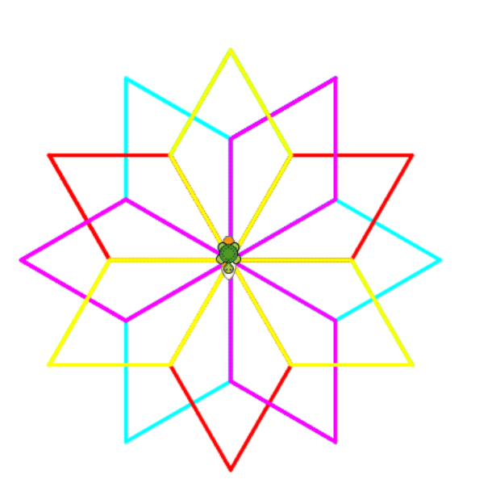
Spot the pattern
to petal
repeat 4
[
fd 100 rt 60
fd 100 lt -120
fd 100 lt -60
fd 100]
end
cs
repeat 6 [
setpc repcount ; repcount = 1, 2, ..., 6 (auto variable inside repeat)
petal
rt 90
] setpc random 15 – also may be used

Slide 16
Question 2
to petal
repeat 8
[fd 100 rt 45]
end
repeat 6 [
setpc repcount ; repcount = 1, 2, ..., 6 (auto variable inside repeat)
petal
rt 60
]

Slide 17
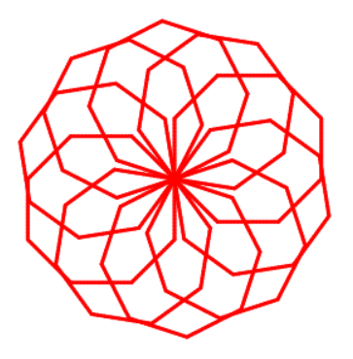

Slide 18
Activity 2.4: Comparing code

Slide 19
Quiz 2

